Slide 1
R-ARM-BOT
ME395 Final Presentation
Adam Pelberg, Bryan Horn, Jerry Yang, Nigel Chew, Yujui Chen
Notes:
Nigel

Slide 2

Motivation - A Greener World
Recycling rate in America is now 32%. Comparison - Germany’s was 72% in 2019
Plastics must be sorted before they can be recycled
Many recyclables become contaminated when placed in the wrong bin.
Contamination can prevent large batches of material from being recycled. Other materials can’t be processed in certain facilities.
SOURCES: https://www.epa.gov/facts-and-figures-about-materials-waste-and-recycling/national-overview-facts-and-figures-materials https://news.climate.columbia.edu/2020/03/13/fix-recycling-america/
Notes:
Nigel
https://news.climate.columbia.edu/2020/03/13/fix-recycling-america/

Slide 3
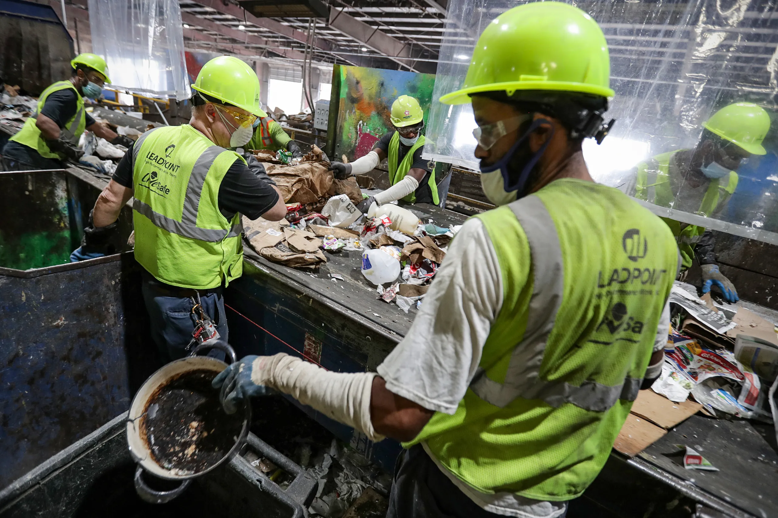
Traditional Recycling Processes
Recycling process now: Materials Recovery Facility (MRF) → conveyor belt → pre-sort removing non-recyclables → sorting area manually sorted by workers
Sorting is dirty, low-paid, and mind-numbing work. ( Usually manually sorted at smaller MRFs )
Current estimate for sorting labor in the US is $5 billion
Sources: https://www.cleantech.com/recycling-and-sorting-from-futility-to-efficiency, https://www.forbes.com/sites/kenrickcai/2020/11/12/rise-of-the-recycling-robots/?sh=3fee204665f9
Notes:
Nigel

Slide 4
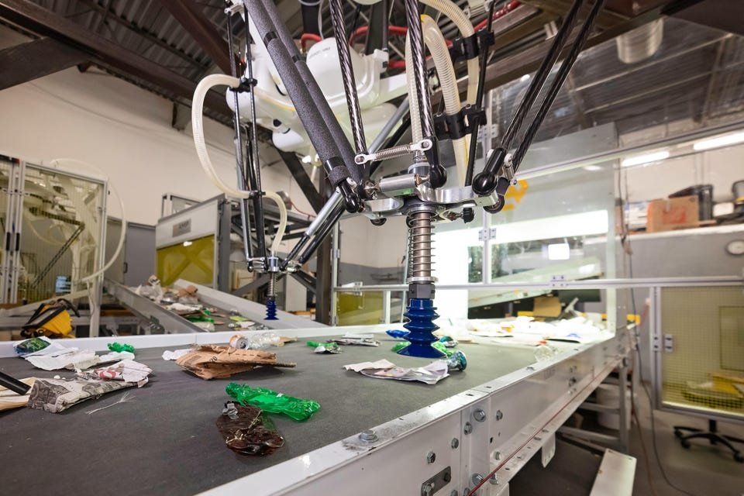
Robots & Recycling
Patents for recycling robots first filed in 1990s
Larger MRFs have automated machines for sorting.
Autonomous optical and waste sorting systems have been a success story in the recycling industry - key players like ZenRobotics and AMP Robotics
Uptick in popularity during pandemic too
Notes:
Nigel

Slide 5
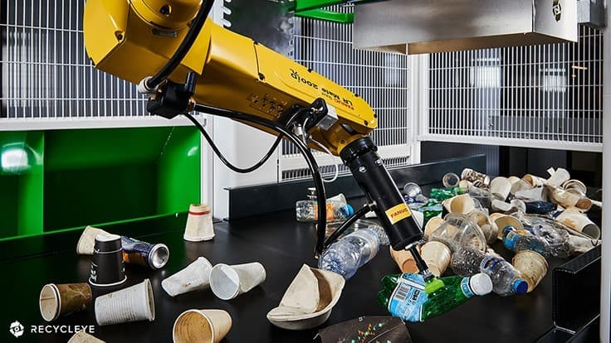
Robots & Recycling
Faster computer processing speeds → potential of deep learning to transform existing automotive manufacturing robots for a range of new conveyor belt-based use cases.
Deep learning to teach the robots how to recognize objects based on colors, shapes, textures and logos.
Robots far more productive than humans: ability to pick up 80 pieces of material per minute vs 40 → each machine can handle the work of at least two employees → workers free to do other skilled jobs at recycling center
Robots are more accurate at waste sorting → recycling facilities, which operate on low profit margins, may be able to improve the amount of recycled material they sell
Notes:
Nigel

Slide 6
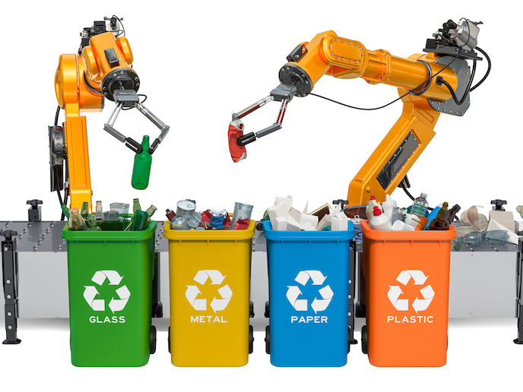
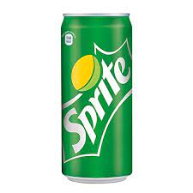
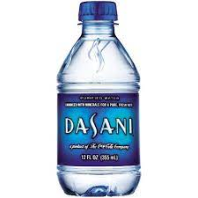
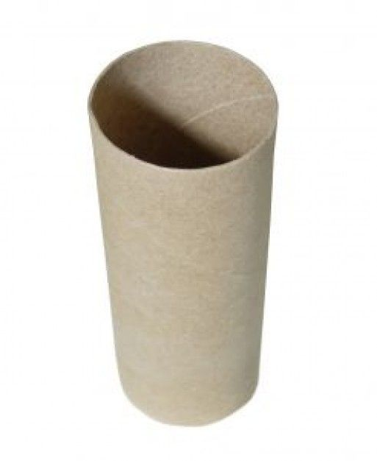
Project Overview
xARM UNO Robotic Arm identifies and picks up different products
Products:
Plastic water bottles / Aluminum soda cans / Toilet paper roll
Products will be on an assembly line
Robot arm places them in separate, designated bins
Notes:
Adam

Slide 7
Timeline
Week 1: Introduction to course and choose project groups
Week 2: Refine project topic to Recycling
Week 3: Begin training on FANUC robot
Week 4: Present initial project idea, build xArm UNO robot
Week 5: Finish training on xArm UNO robot
Week 6: Design robot base and conveyor, program robot motion path
Week 7: Build robot base, purchase parts for conveyor, program robot sensors
Week 8: Test and iterate motion path + sensor code, build conveyor
Week 9: Implement conveyor with final assembly, code conveyor motor logic
Week 10: Present project
Notes:
Adam

Slide 8
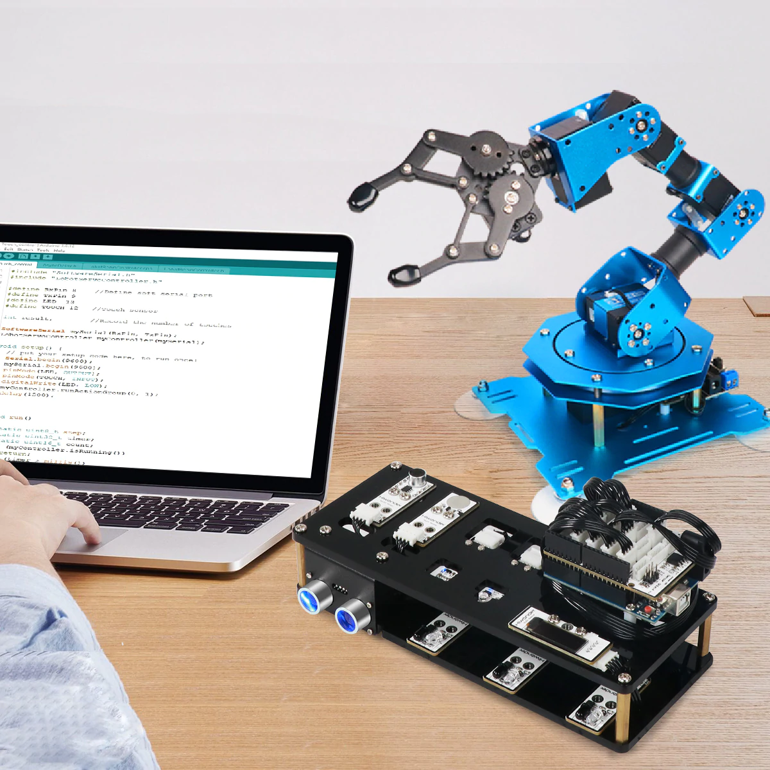
Hiwonder xArm UNO Robotic Arm
6 servos (5 dof + gripper)
Arduino Programming
Sensor Kit:
IR Sensor
Color Sensor
OLED Screen
Touch, Sound, Light, Ultrasonic sensors
Notes:
Adam

Slide 9
How it Works
Items randomly arrive on the conveyor belt
IR sensor recognizes when an item is in front of the arm and stops the conveyor
Color sensor identifies object
With this information, robot picks up object and drops it in the designated bin
Notes:
Bryan

Slide 10

Notes:
Bryan

Slide 11
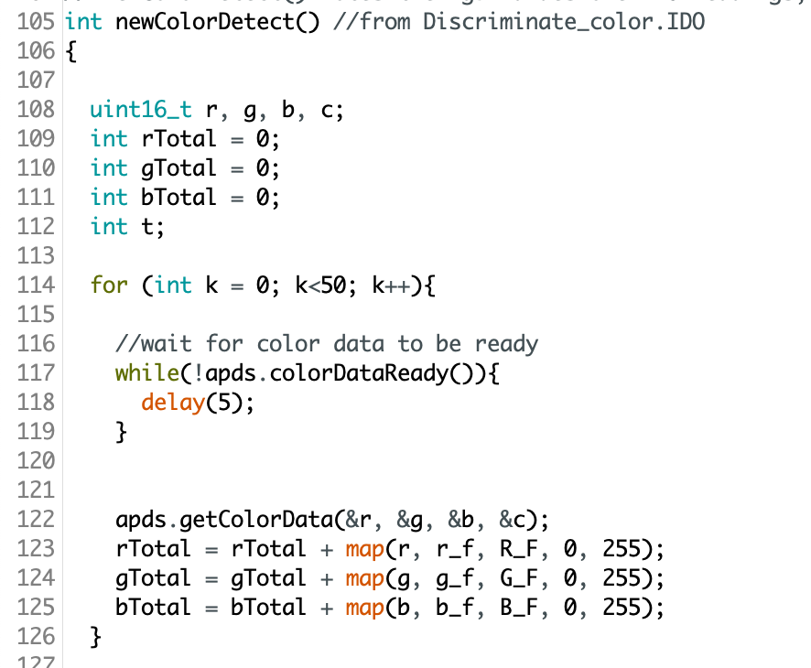
Color Detection
Averaged 50 color readings to get a single value
A single reading was found to be unreliable
Located optimal position from sensor to object
For any color to be read, max[r,g,b] > 80
Needed to add blue tape to the water bottle to make it “blue” enough
Notes:
Bryan

Slide 12
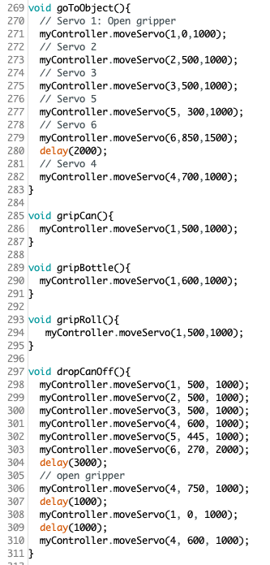
Motion Planning
Four discrete positions: where the motor picks up the object and the three bins
Robot arm has six servos
Documented the position of each using trial and error
Found the positions to be reliable over many consecutive trials
Notes:
Bryan

Slide 13
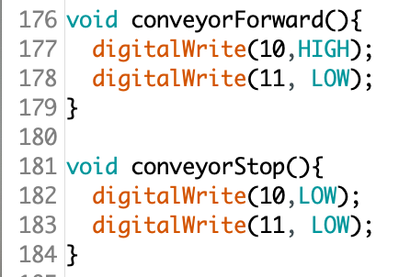
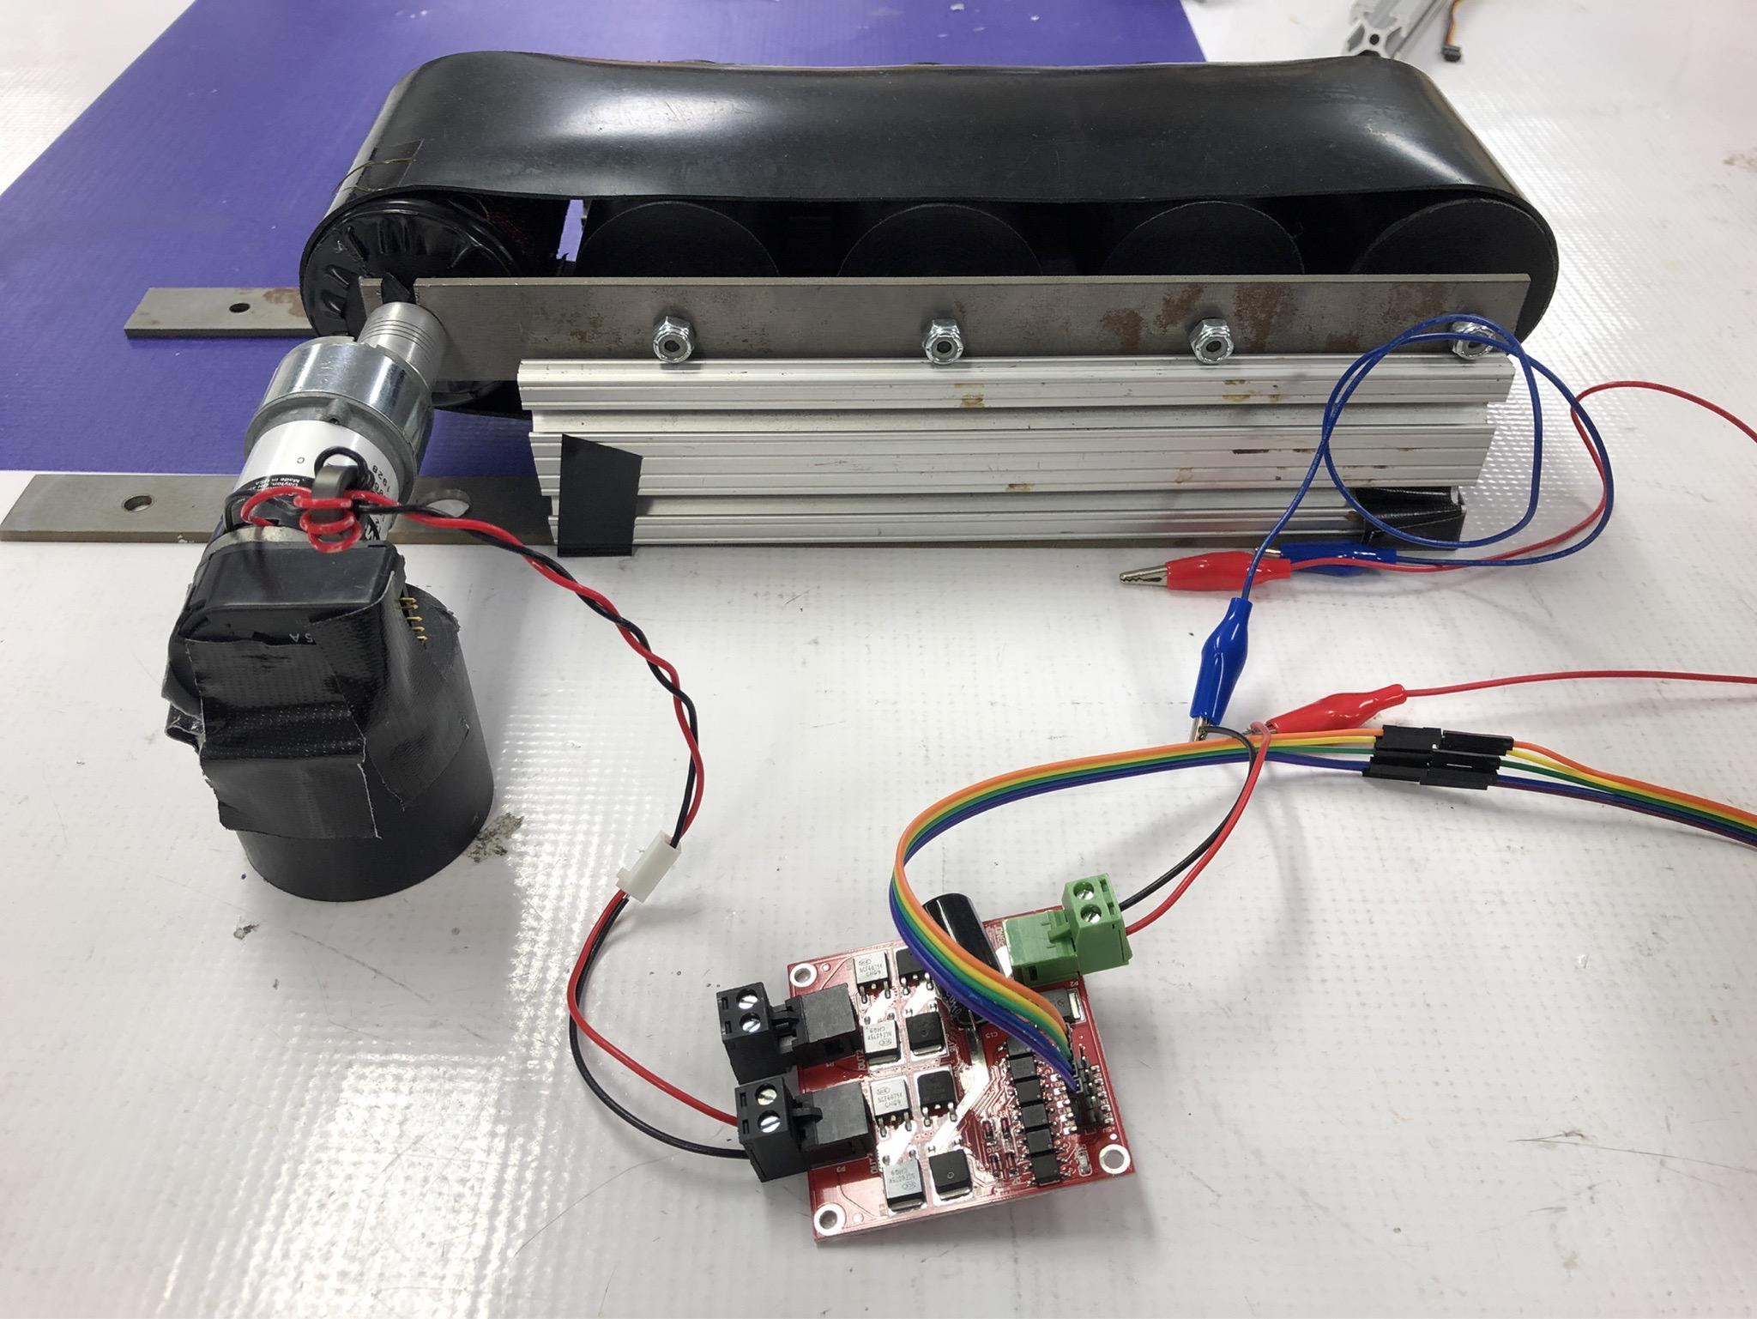
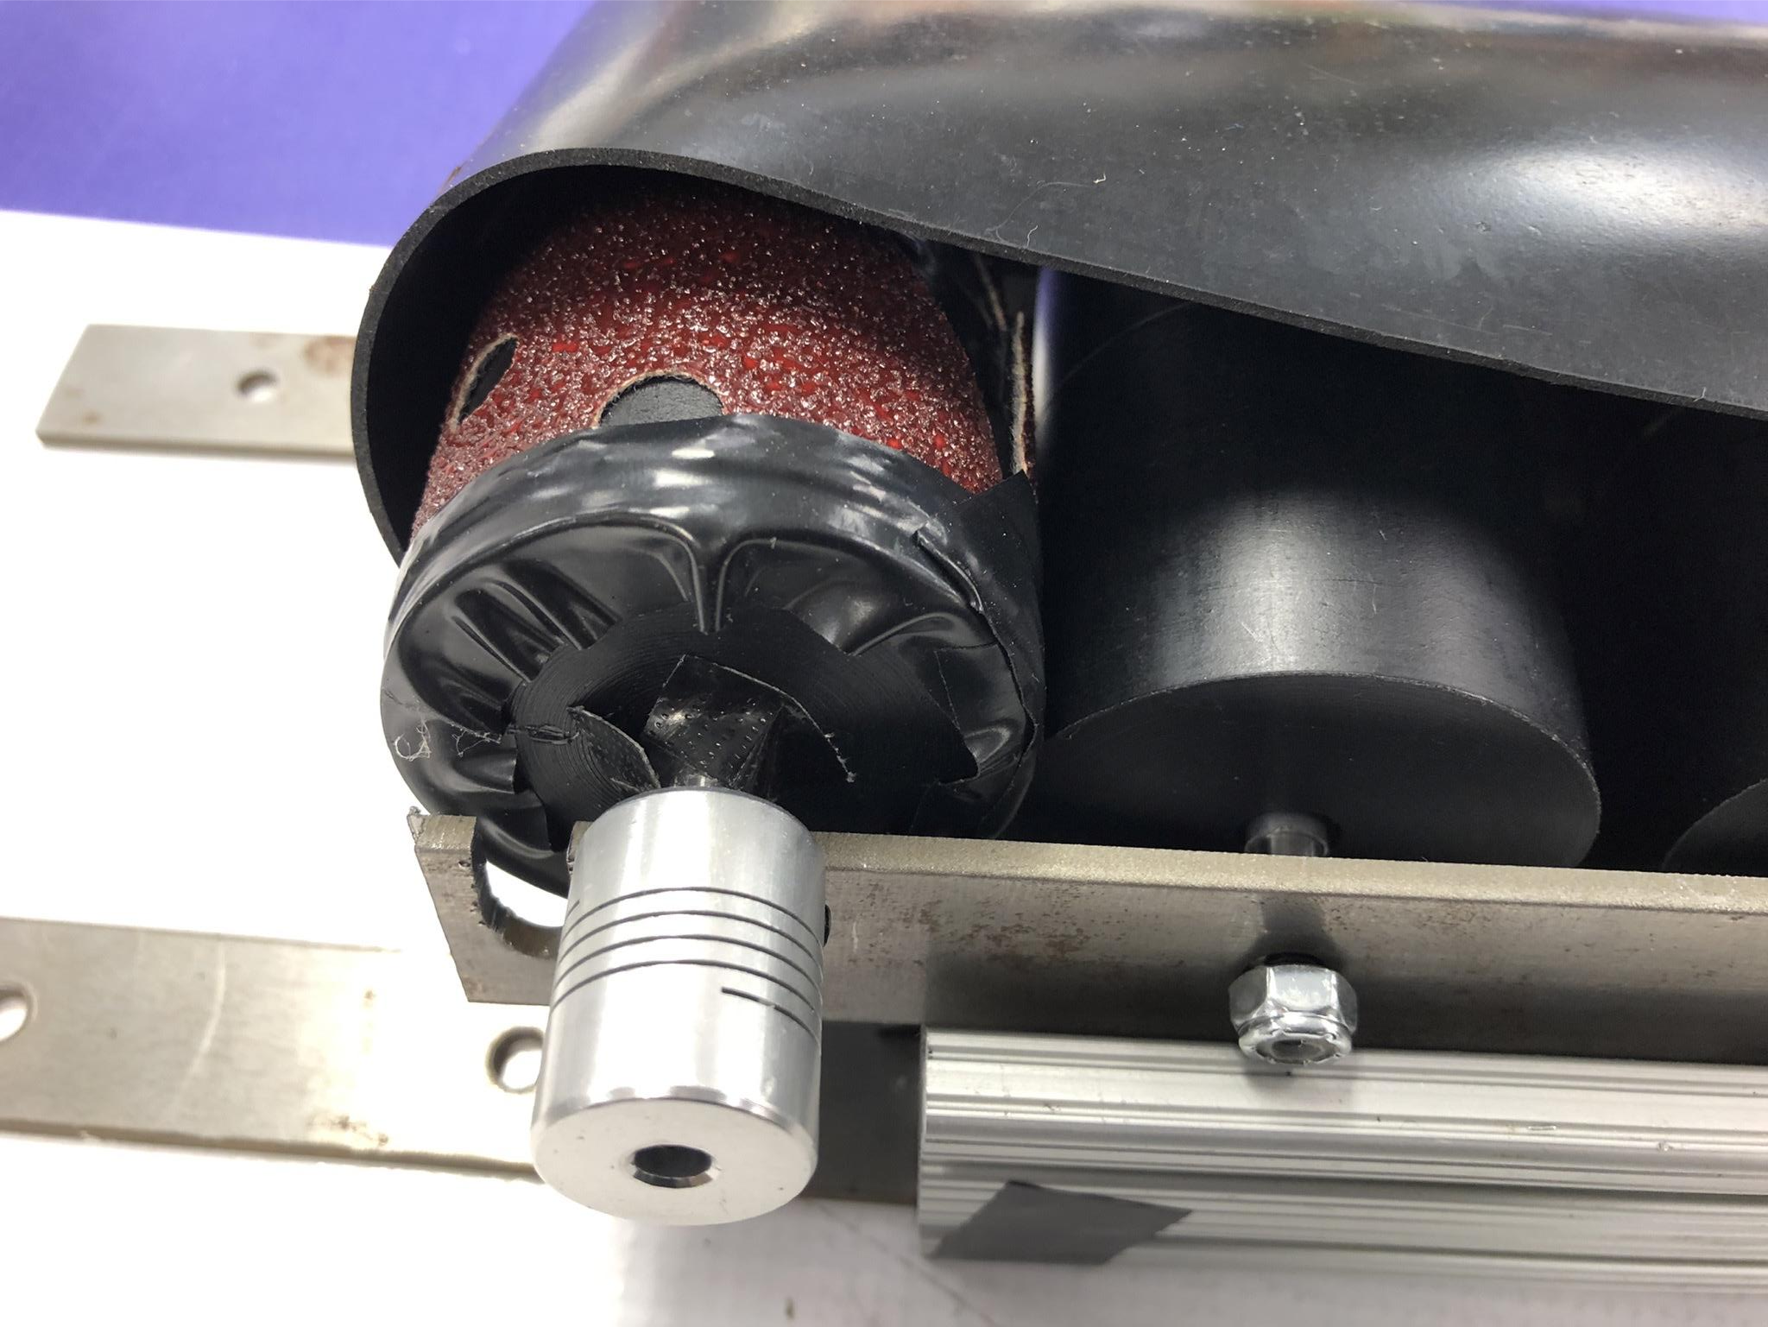
Conveyor Belt
Motor: High torque with low speed
With high torque, it has the ability to move items with high mass
Motor Driver: L298N
Uses 9V battery as a power source
Signal given by the same Arduino Uno as robot arm
Conveyor Prototype:
Add sand paper on the roll to increase friction
Notes:
Ray

Slide 14
Potential Future Developments
Implement computer vision for object detection
Color sensor works for this scenario, but is unreliable at times and doesn’t scale to other objects easily
Design more robust gripper for larger objects
Needed small objects to grip with this robot
Speed up entire system
Cycle time is very slow, won’t scale well
Notes:
Jerry

Slide 15
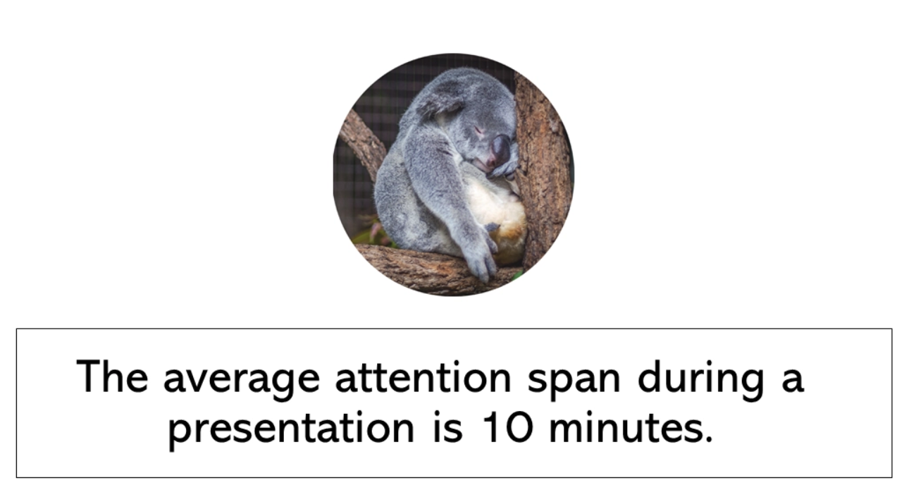
Q&A
Notes:
Jerry

